Slide 1
Lesson 11 Week 11
Exercises on JavaScript & Revision

Slide 2
INTRODUCTION
Scripting languages are simple interpreted programming languages. Most popular among these scripting languages is JavaScript. JavaScript helps to make web pages more interactive. With JavaScript, web pages should no longer be static. Unlike Java programming, JavaScript is simpler and need not be complied.

Slide 3
OBJECTIVES
At the end of this unit, you should be able to:
identify where to put your scripts in an HTML document
create how to hide scripts from old web browsers
create how to put comments in scripts
create how to display messages using alert, confirm, and prompt boxes
create how to call functions with a button.

Slide 4
JavaScript Files
JavaScript is a scripting language that can be used on both client and server side. JavaScript add interactivity to Web pages. It assists in completion and checking of forms and also provides user control with client-side of page appearance and content.
Types of JavaScript
1. Client side - runs on browser
2 .Server side - runs on server - embedded in web page but processed on server.

Slide 5
Placing Scripts
If the JavaScript code is short, it can be included in the HTML document.
1. in Head tag - this prevents user triggered errors during downloading
2. in body - including within body tag as an attribute
3. within forms as Event handlers - script tag not required
It can be also placed in a separate .js file
To add clarity to an HTML document.
To share JavaScript code across multiple HTML documents.
To hide the script code.
In this case, viewer can only see the location of the script file but not the contents.
Scripts are embedded in pages between <script> </script>tags
Format <script type=”text/JavaScript”>
Statement;
</script>
NOTE: src attribute can also be placed in the script tag but this is not supported by Internet Explorer.

Slide 6
Comment TAGS
JavaScript supports two types of comment: (just like the normal C++ and Java)
// for single line comment
/* */ for multiple line comments
Adding comment to your script is very important so that you and others will know what various sections of code is used for.

Slide 7
Hiding JavaScript from Old Browser
Browsers that were created before the script tag was invented will correctly ignore tags they do not understand. Such browsers will treat script language as ordinary plain text. To get around this, the script code can be written inside HTML comment tag (<!-this is a comment. ->).
Let’s see how this is done.
Example 1:
<HTML>
<HEAD>
<TITLE>The Scripting Language</TITLE>
<SCRIPT Language = “JavaScript”>
<!-- //Hide Script from non-script browsers
document.write ("<P>Older browser that do not understand the SCRIPT tag will ignore it " )
document.write ("and treat the script statements inside the SCRIPT tags as HTML</P>")
// -->

Slide 8
</SCRIPT>
</HEAD>
<BODY>
<H1>The Script Tag: Example 3</H1>
<P>
<SCRIPT Language="JavaScript">
<!--
document.write("To do this we also surround the script statements ")
document.write("with HTML comments. We also must preface the closing ")
document.write("HTML comment tag with a JavaScript comment //")
// -->
</SCRIPT>
</P>
</BODY>
</HTML>

Slide 9
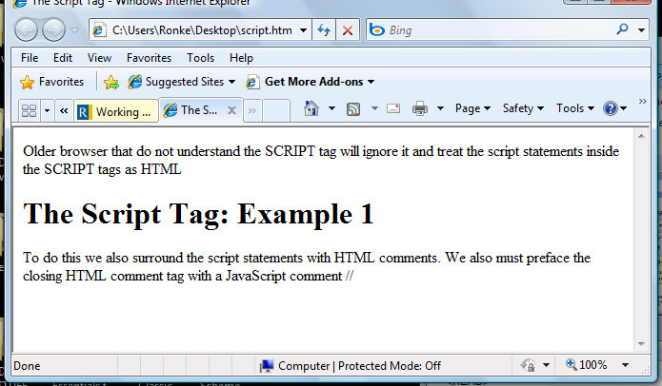
Figure 1.1: Example 1

Slide 10
EXERCISE
Create another file for Example 1 above; remove the HTML comment tags that used to wrap the JavaScript. Run the code and compare the output with Example1 above.
If your output is the same with Example 1 output above, it means your browser is a recent version. So you can continue to run your script without putting the script statements in HTML comment tag provided it is not a project.
NOTE: If you are using Windows Vista or latest Internet explorer like Explorer 7 and above, you will have to right click on “allow blocked content” and click yes for your browser to display script content as displayed below.

Slide 11
JavaScript Variables
JavaScript accepts the following types of variables:
Numeric: Any numeric value, whether a whole number (an integer) or a number that includes a fractional part (a real), e.g., 23, 2.412
String: collection of characters e.g. Titi, University.
Boolean: a True or False
Note:
JavaScript is not strongly types like java programming.
Type of variables are not declared
Variable names are case sensitive in JavaScript!
Must start with letter or "_". Any combination of letters, numbers, "_"
When a new variable is created or declared, it must be preceded by the word var
No need to end statements with a semicolon
New line is assumed to be a new statement
Examples of JavaScript variables:
var age = 25 (numeric)
var surname = “Oladele” (String)
var married = True (Boolean)

Slide 12
Operators
Operators are types of command. They act on variables and/or literals and produce results.
1. Binary Operators: binary operators are operators that accept only two inputs. JavaScript support the following operators:
+Addition
Subtraction
/ Division
Multiplication
% Modulus
2. Unary Operators: unary are operators that requires only one value as input
++ Increment Increase value by 1
-- Decrement Decrease value by 1
- Negation Convert positive to negative, or vice versa
Examples:
5++ = 5 increase 5 by 1
6-- = 5 decrease 6 by 1
-5 = -5 negate 5 so it becomes -5

Slide 13
3. Comparison Operator: As well as needing to assign values to variables, we sometime need to compare variables or literals.
Comparison Operators compare two values and produce an output which is either true or false. Different from the assignment operator, the comparison operator tests to see if variables (values)
are already equal to one another. The following are comparison operators supported by Jascript:
== (two equals signs): it means ‘is equal to’.
e.g. registeredStudents == totalStudents
!= (an exclamation mark followed by equals sign): it means ‘is NOT equal to’.
e.g. registeredStudents != totalStudents
< means ‘less than’
> means ‘greater than’
<= means ‘less than or equal to’
>= means ‘greater than or equal to’

Slide 14
4. Assignment operator (=): which means 'becomes equal to. The assignment operator makes two things equal to one another.
5. Combined Operators: we can also combine these operators and the assignment operator in following ways:
+ = ‘becomes equal to itself plus’
-= ‘becomes equal to itself minus’
*= ‘becomes equal to itself multiplied by’
/= ‘becomes equal to itself divided by’
%= ‘becomes equal to the amount which is left when it is divided by’
Example:
total += Sum
Means: total = total + sum

Slide 15
6. Logical Operators: these operators are used to combine results of other conditional tests. They are:
&& Logical AND
| | Logical OR
Example:
if (x > 2 && x < 10)
Placing the && between the two conditions means that if statement will only be carried out if BOTH conditions are true. If only one of the conditions is true (e.g., x is greater than 0 but also greater than 10) the condition will return false and the if statement won't be carried out.
7. Concatenation operator (+): the character concatenation operator + is used to join text, number and characters. This is commonly used when you have to combine long sentence or words taking from different input fields.

Slide 16
JavaScript Control Flow
The power of programming languages comes from their ability to respond in different ways depending upon the data they are given. Every programming language that supports dynamic content includes
statements which allow ‘decisions’ based on data given. JavaScript supports loop and conditional construct.
1. The for Loop: it allows you to carry out a particular operation a fixed number of times. The for is controlled by setting three values:
an initial value
a final value
an increment
Format: For (initial value; final value; increment)
{
Statements(s);
}
Example:
for (x=5; x>=0; x--)
{
alert(‘x = ‘ + x);
}

Slide 17
2. If …Else statement: it makes decision to be made between alternative choices based on one condition. The If-Else statement in JavaScript has the following syntax:
if (condition)
{
statement;
Statement
}
Else
{
statement;
Statement
};

Slide 18
NOTE:
Always observe the positioning of the semi-colons. If you are using both the if... and the else... parts of the statement, it is important NOT to put a semi-colon at the end of the if... part. If you do, the else... part of the statement will never be used. A semi-colon is normally placed at the very end of the if...else... statement, although this is not needed if it is the last or only statement in a function.

Slide 19
3. The While Loop: The while loop like the for loop allow you to carry out a particular operation a number of times.
Format:
While (condition)
{
Statement(s);
}
Example:
var x = 30;
alert (“Count …”);
while (x > 0)
{
x--;
};
Alert (“Finished!”);

Slide 20
NOTE
Here, x is initially set to a high value (30). It is then reduced by one each time through the loop using the decrement operator (x--). So long as x is greater than zero the loop will continue to operate, but as soon as x reaches zero the loop condition (x > 0) will cease to be true and the loop will end.

Slide 21
Example 2: Open your notepad and type the following lines of code. At the end of this practice, you will practically see how loops work in JavaScript.
<HTML>
<HEAD>
<TITLE>Testing JavaScript Loop Statement</TITLE>
<PRE>
A for loop that writes out the numbers from 0 through 9 and labels them as being odd or even.
</pre>
<SCRIPT Language="JavaScript">
<!--
for (i=0; i < 10; i++) {
if (i%2!= 0)
document.writeln(i + " is odd")
else
document.writeln(i + " is even")
}
// -->
</Head>
</SCRIPT>
< </HTML>

Slide 22
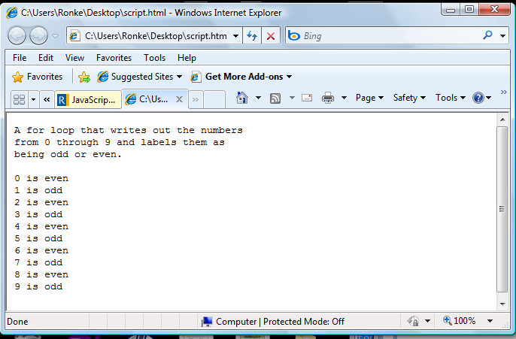
Output
Figure 1.2: Example2 Output

Slide 23
Assignment
Use the for statement to write a script to find the sum, square and square root of even number between 1-100
Write a JavaScript code to compute the factorial of any positive number.
Write a JavaScript code to test if a number is even or odd.
Assuming you have two end points 10 and 100. Write a JavaScript code to generate all the numbers between them.

Slide 24
EXERCISE
Modify the script in example two above to write out only the even numbers from 0 through 9.
Carry out example 2 using While loop statement for both odd and even numbers.

